Slide 1


Slide 2
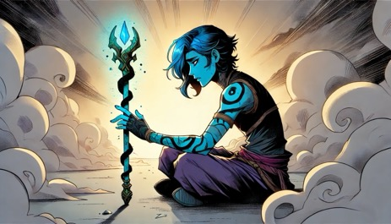
Is This In My Head?
The twitching began at dawn - subtle muscle spasms in Zyra's right arm that made her glowing staff tremble. She stared at the offending limb, cobalt-blue skin shimmering with nervous energy. Three lunar cycles had passed since her battle with Atroxys, yet the barbed chain's dark energy still coursed through her veins like poison.

Slide 3
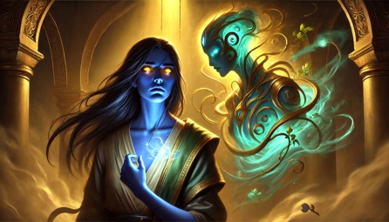
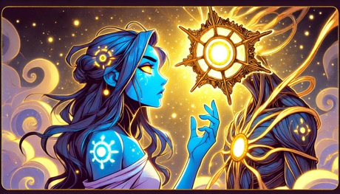
"Still hiding from your own shadow?" came a voice like wind chimes made of starlight. From the morning mist emerged Credo - a swirling constellation of light particles forming an ornate lantern. Its iridescent filaments pulsed in rhythm with Zyra's quickening heartbeat.
"I'm not hiding," Zyra snapped, clutching her twitching arm. "I'm... strategizing."
Credo's light dimmed to a compassionate glow. "The wound speaks louder when unacknowledged. Atroxys's darkness isn't just in your arm - it's in the stories you tell yourself."
Notes:
External Link
Description

Slide 4
The Whispering Woods
Zyra and Credo journeyed through the Bioluminous Forest where trees hummed with ancestral wisdom. Giant foxglove flowers bloomed with emergency flares of pink light whenever Zyra's arm spasms intensified.
"Here." Credo illuminated a glowing lichen patch. "The Lullaby Lichen's song eases-"
A thunderous CRACK split the air. From the decaying earth emerged Atroxys's minions - Shardlings made of corrupted crystal, their jagged forms reflecting Zyra's fearful face a thousand times over.
Zyra's staff flared turquoise. "I beat your master once!"
"Once," the Shardlings echoed in a glassy chorus. Their reflections showed Zyra's arm now blackened to the elbow.

Slide 5
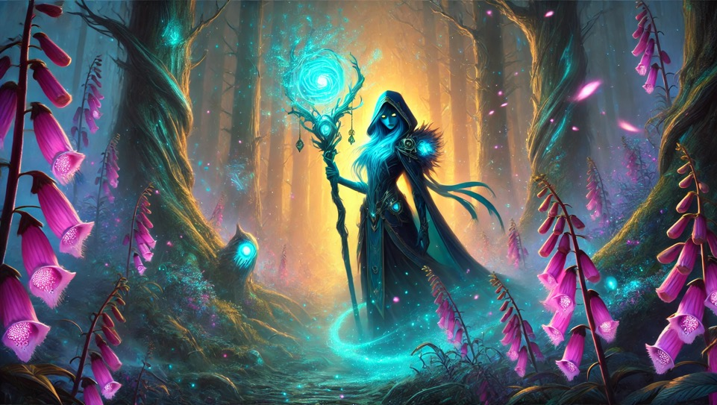

Slide 6
The Trial of Tears
In the Cavern of Echoing Pain, Credo's light revealed walls weeping silvery sap. "The Weeping Willow's tears," Credo explained. "They reveal truth... and truth heals."
As Zyra collected the glowing sap, the cavern walls projected her deepest fears - patients she'd failed to save, villages swallowed by Mnemoros's memory storms. Her blackened arm pulsed in time with each devastating memory.
"Your power comes from compassion, not combat," Credo urged. "Heal yourself as you'd heal others."
Notes:
External Link
Description

Slide 7
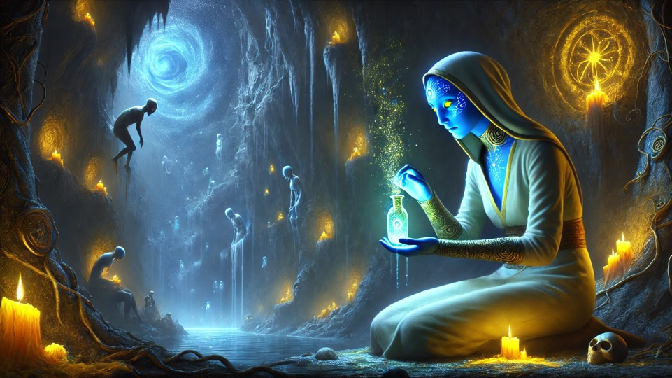
Notes:
Episode 2: The Journey

Slide 8
The Grove of Second Chances
Their final test came in a grove where trees grew upside down, roots cradling starlight. Here grew the Moonpetal Salve - a flower blooming only in self-forgiveness.
As Zyra reached for it, the ground erupted. Atroxys himself emerged, chain whipping through the air. "You'll make an excellent vessel for my master!"
Notes:
External Link
Description

Slide 9
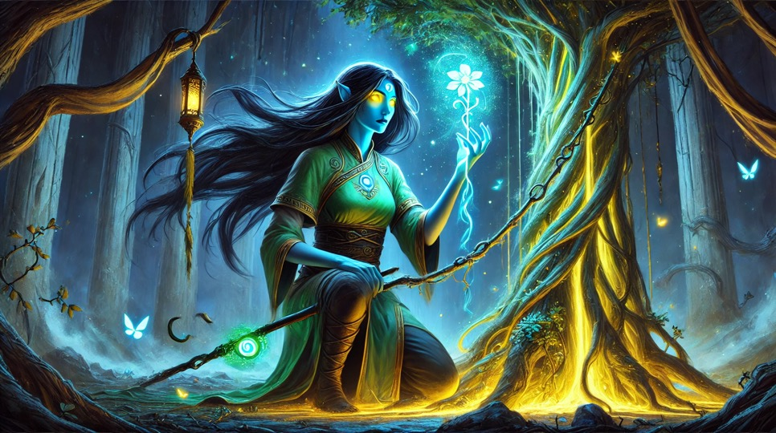
Notes:
Name: First Encounter
We are directed to seek the path through the mountain

Slide 10
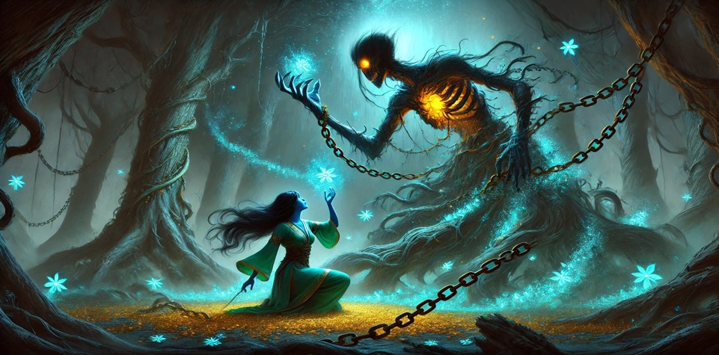
Zyra faltered, her corrupted arm now dragging like stone. Credo surged forward, filaments weaving a protective lattice. "The salve, Zyra! Now!"
Notes:
Name: Go Deeper

Slide 11
The Unlikely Victory
With Credo containing Atroxys in a cage of light, Zyra crushed the Moonpetal. The salve's glow spread up her arm like liquid starlight, pushing back the corruption. Her staff blazed brighter than ever as she chanted:
"From earth's pain, healing springs,
From shadow's chain, hope takes wings!"
The resulting energy wave shattered the Shardlings and sent Atroxys recoiling. "This changes nothing!" he roared before dissolving into smoke.
Notes:
External Link
Description

Slide 12
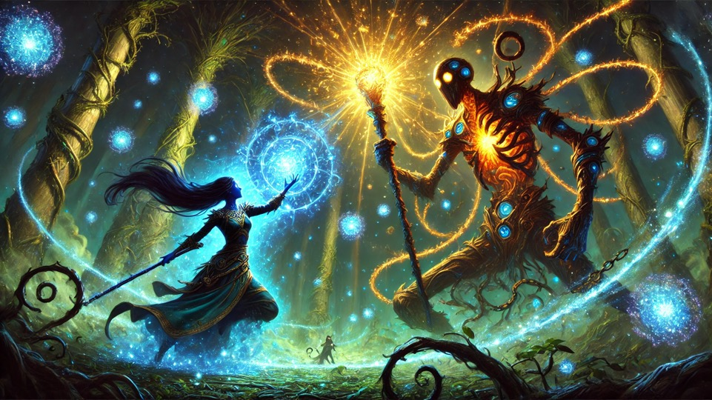
Notes:
Name: Go Deeper

Slide 13
The First Leaf
In the healed grove, Zyra examined her arm - now patterned with luminous veins like cracked porcelain repaired with gold.
"Beautiful," Credo chimed. "Scars become strength when tended with care."
Zyra smiled faintly, watching a new leaf unfurl on a once-withered tree. Somewhere, Mnemoros whispered through the leaves: "All growth begins with damage..."
One small victory in the endless war for healing.
Notes:
External Link
Description

Slide 14
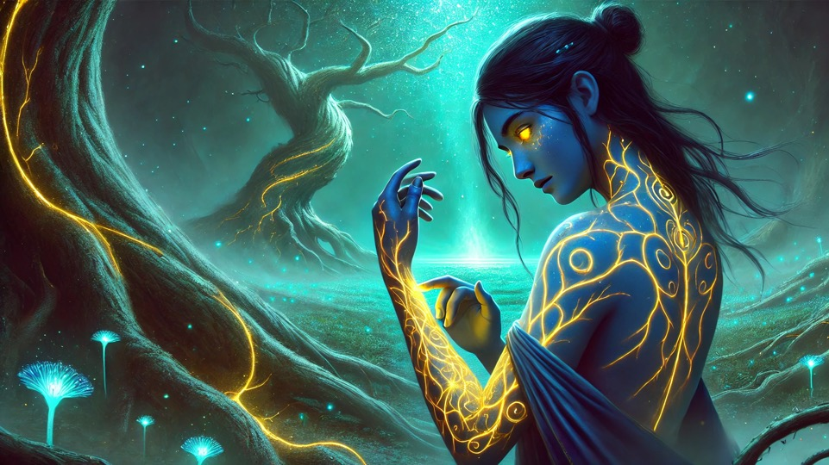
Notes:
Name: Go Deeper

Slide 15
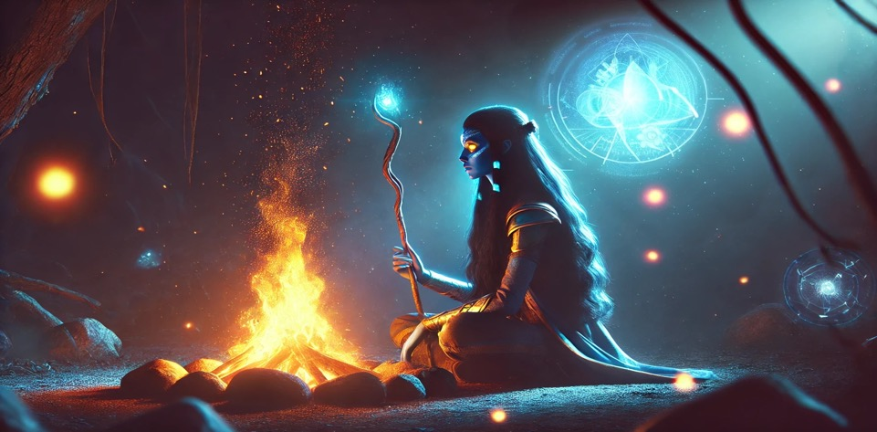
Where will Zyra’s journey lead next. We do not know, but we will continue the journey for the betterment of us all. The Healing Project.
Notes:
Name: Go Deeper

Slide 16
Join us to help write what happens next.

Slide 17
Thank You

